Slide 1
Te Atatū Peninsula Business Association
2024 - 2027

Slide 2
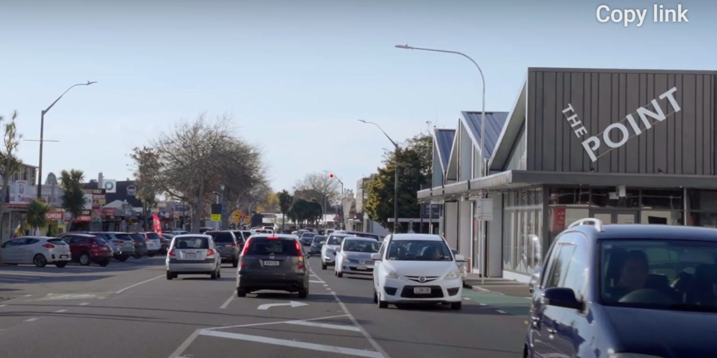
Vision
Te Atatu Peninsula town centre is attractive, safe, and convenient. It is a drawcard for our community and visitors, who experience a sense of belonging and well-being.

Slide 3
Mission
TAPBA ensures our welcoming town centre prioritises well-being, safety and convenience.

Slide 4
Goals
01. Successful advocacy & planning
02. Safety & well-being for all
03. Enhanced Peninsula lifestyle
TAPBA successfully advocates, collaborates and plans, to mitigate challenges around congestion, infrastructure and town centre design.
TAPBA takes a comprehensive approach to discourage and prevent crime, ensuring a sense of safety and well-being for customers, residents and visitors.
TAPBA initiates and collaborates with others, to provide activities and events. Enjoyment of the Peninsula’s natural attractions is enabled.
.
03. Peninsula life-style
4

Slide 5
Implementation Plan 2022 – 23
Implementation Plan 2024 – 25 (Date of review – Nov 2023)
Goal 1 – Successful advocacy & planning
e of review - September 2022)
Goal 1 – Support local businesses to flourish
Priority Initiatives | Timeframe | Key relationship & Lead | Measurement
Advocate, collaborate and plan, to mitigate challenges around congestion, infrastructure and town centre design.
- collaborate with Henderson Massey Local Board to move forward with Community Planning Project. Ensure the right agencies take part; work toward solutions to mitigate effects of intensification and congestion; - communicate progress & updates with community. | - Jan 2024 On going | HMLB HMLB/ TAPBA | Number of communications; number of agencies regularly meeting; public feedback Number of communications
- continue to advocate for a traffic/transport review | - On going | TAPBA/HMLB | Successfully initiate review
- continue to advocate for town centre Masterplan | - On going | TAPBA/HMLB | Successfully initiate formation of plan
- investigate ‘outside the box’ solutions e.g. Reinstate school buses coupled with Park n Ride | - April 2024 | TAPBA/Auckland Transport/ schools | Buy-in from strategic partners

Slide 6
Goal 1 cntd
Priority Initiatives | Timeframe | Key relationship & Lead | Measurement
- Investigate impact of existing town centre trees on drains and gutters | May 2024 | TAPBA/ arborist | Results of investigation
- Collaborate with Te Atatu Residents and Ratepayers Assoc. To strengthen organisation | Jan 2024 | Manager/ R&RA | Organisation re-establishes and becomes a strong voice for community

Slide 7
Goal 1 - Safety & well-being for all
Priority Initiatives | Timeframe | Key relationship & Lead | Measurement
Take a comprehensive approach to discourage and prevent crime, ensure a sense of safety and well-being for customers, residents and visitors.
- Fund raise to install CCTV cameras in vital areas, to discourage crime and illegal dumping and to assist Police Advocate for more lighting in public areas | Feb 2024 | TAPBA/ funders | Funds raised
- Investigate adoption of collaborative crime prevention tools e,g, Auror, (shops have access; download incident footage, report goes through to Police.). | March 2024 | TAPBA/Police | Numbers of businesses involved

Slide 8
Goal 3 - Enhanced Peninsula lifestyle
Priority Initiatives- | Timeframe | Key relationship & Lead | Measurement
TAPBA initiates and collaborates with others, to provide activities and events. Enjoyment of the Peninsula’s natural attractions is enabled.
- Investigate how new residents can be welcomed into community | May 2024 | TAPBA/ Kāinga Ora/ R&RA | Number of new residents contacted
- investigate installation of murals depicting the history of the town | Jan 2024 | TAPBA/Te Atatu Walls | Mural(s) in place
- investigate creating snap-shot of Te Atatu on film to feature in public space, | June 2024 | TAPBA/Community hub | Film displayed

Slide 9
Goal 3 - Enhanced Peninsula lifestyle cntd
Priority Initiatives- | Timeframe | Key relationship & Lead | Measurement
Continue with plans to establish a weekend market | Established by April 2024 | TAPBA | Markets held successfully, number of stall holders; number of attendees; sales
Advocate to see completion of Peninsula walkway | On going | TAPBA/HMLB | Funds allocated; plans drawn
Investigate holiday activities for older children; consider partnering with library and community centre hub | Jan 2024 | TAPBA/ Community hub | Number of children attending
Work with Parade committee to strengthen event and increase TAPBA’s involvement on the day | April 2024 | TAPBA Manager/ Parade Committee | Meetings attended
- Advocate for more meeting and relaxation spaces in the town centre | August 2024 | TAPBA/Auckland Council | Plans in place; funding allocated

